Slide 1
Virtual Machines

Slide 2
IaaS Cloud Services
Azure VMs are on-demand, scalable computing resources.
Part of IaaS
IaaS is an instant computing infrastructure, provisioned and managed over the internet.

Slide 3
Business Scenarios
Test and Development
Website Hosting
Storage, Backup and Recovery
Web Apps
High Performance Computing
Big Data Analysis
Extended Datacenter

Slide 4
Planning Checklist
Start with the network
Name the VM
Decide the location of VM
Determine the size of VM
Pricing Model
Storage for the VM
Select the Operating System

Slide 5
Name the VM
Element | Example
Environment | Dev, prod, QA
Location | Uw, ue
Instance | 01,02,03,04,05,06,07
Product or Service | service
Role | Sql, web, messaging
Devusc-webvm01 – First development web server hosted in US South Central

Slide 6
Location
The location can limit your available options
There are price differences between location

Slide 7
Pricing
Compute Cost – Per-minute basis
Consumption Based – Pay As You Go
Reserved Instance – Reserve VM for 1 year or 3 year.
Storage Cost – Storage that VM uses.

Slide 8
Virtual Machine Sizing
General Purpose
Compute Optimized
Memory Optimized
Storage Optimized
GPU
High Performance Compute
Note: Be cautious when resizing the production VMs, it leads to a small amount of downtime

Slide 9
Virtual Machine Disk
OS Disk
Temporary Disk – Non-persistent
Data Disk

Slide 10
Supported OS
Windows
Linux

Slide 11
Creating and Connect to the VM
Windows RDP – 3389
Linux SSH - 22

Slide 12
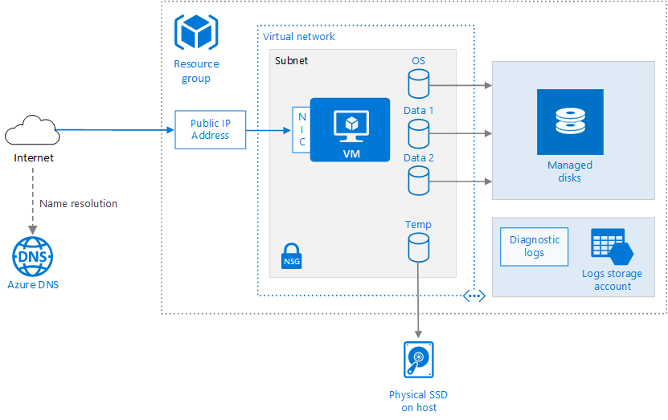

Slide 13




Stoping the VM
Closing the RDP
Shutdown
Disconnect
Stop using Powershell
Stop Using CLI
Stop Using Azure Portal
Deallocate

